Slide 1

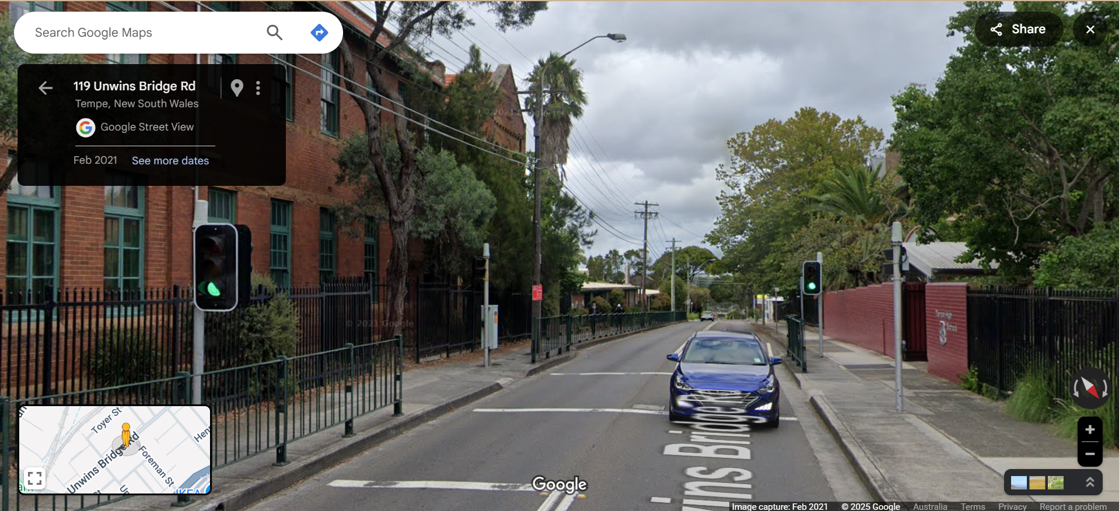

Pi Pico OOP Mini Project
Ben Jones
Tempe High School
Lecture 4
Notes:
Welcome to Lecture 4, up to this point, we have developed a fully functioning LED_light class and written a unit test to verify its behaviour.

Slide 2
Simple Open Loop Control System
Traffic Lights remain green until pressed (idle state).
Button pressed triggers state change.
Lights rotate through a pattern based on time.
System returns to idle state
Notes:
Now, we will develop a class for the pedestrian button. This button will be responsible for initiating the state change in our system.

Slide 3
Today
Implement a basic button Class
Create an interrupt and debounce the button
Unit test the pedestrian button
Notes:
Today, we will:
Implement a basic button class tailored for our system
Create an interrupt to listen for button events
Debounce the button to ensure reliable input
Develop a unit test and documentation for the button class

Slide 4

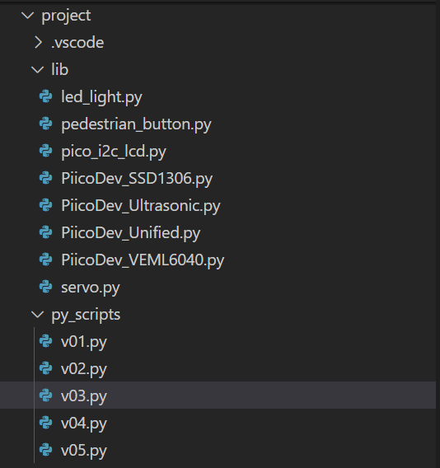
Create new files
v05.py in project\py_scripts\
pedestrian_button.py in project\lib\
Notes:
It is good practice to create a new versioned script for each feature. This approach documents our development progress and ensures that unit tests are easy to reuse in the future. Start by creating a new file (e.g., v05.py) in the py_scripts folder, where you will implement your unit test. Then, create a separate file for the pedestrian_button class in the lib folder to keep your class implementation organised and abstracted.

Slide 5
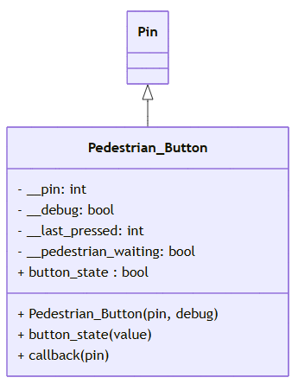
UML
Notes:
This is the UML diagram for the class we will develop today. The class inherits from the PIN class, it will not implement any polymorphism.

Slide 6
Pedestrian_Button Imports
from machine import Pin
from time import ticks_ms, ticks_diff
Notes:
These are the imports we will need

Slide 7
Pedestrian_Button Class Initialiser & Attributes
Class Pedestrian_Button(Pin):
# Sub Class inherits the Super 'Pin' Class
def __init__(self, pin, debug):
super().__init__(pin, Pin.IN, Pin.PULL_DOWN)
self.__debug = debug
self.__pin = pin
self.__last_pressed = 0 # Track the last time the button was pressed
self.__pedestrian_waiting = False
Notes:
The class initialiser first calls the initialiser of its super class, it then stores its attributes as encapsulated (private) variables.

Slide 8
Pedestrian_Button “Getter”
def button_state(self, value=None):
if value is None:
# Getter
if self.__debug:
print(f"Button connected to Pin {self.__pin} is {'WAITING' if self.__pedestrian_waiting else 'NOT WAITING'}")
return self.__pedestrian_waiting
Notes:
Due to our system design, this getter differs from what is typically implemented for a button. Instead of checking whether the button is currently being pressed, it determines whether the button has been pressed at all, based on the state of __pedestrian_waiting.

Slide 9
Pedestrian_Button “Setter”
def button_state(self, value=None):
if value is None:
# Getter
if self.__debug:
print(f"Button connected to Pin {self.__pin} is {'WAITING' if self.__pedestrian_waiting else 'NOT WAITING'}")
return self.__pedestrian_waiting
else:
# Setter
self.__pedestrian_waiting = bool(value) # Convert to boolean to ensure proper type
if self.__debug:
print(f"Button state on Pin {self.__pin} set to {self.__pedestrian_waiting}")
Notes:
Normally, a button would not require a setter. However, in our case, we need to reset the __pedestrian_waiting state once the pedestrian walk phase has ended, so that the system is ready for the next pedestrian.

Slide 10
Pedestrian_Button Interrupt
Class Pedestrian_Button(Pin):
# Sub Class inherits the Super 'Pin' Class
def __init__(self, pin, debug):
super().__init__(pin, Pin.IN, Pin.PULL_DOWN)
self.__debug = debug
self.__pin = pin
self.__last_pressed = ticks_ms() # Track the last time the button was pressed
self.__pedestrian_waiting = False
# Set up interrupt on rising edge
self.irq(trigger=Pin.IRQ_RISING, handler=self.callback)
Notes:
Instead of continuously checking whether the button has been pressed, which wastes resources, we will use an interrupt. An interrupt allows the hardware to monitor for a change in state constantly. When this state change occurs, it automatically calls a handler method. In our case, the interrupt will wait for a rising current, known as a rising edge. When this happens, it will call the self.callback() method.

Slide 11
Pedestrian_Button Interrupt Callback Method
def callback(self, pin):
current_time = ticks_ms() # Get the current time in milliseconds
if (ticks_diff(current_time, self.__last_pressed) > 200): # 200ms debounce delay
self.__last_pressed = current_time
self.__pedestrian_waiting = True
if self.__debug:
print(f"Button pressed on Pin {self.__pin} at {current_time}ms")
Notes:
This section outlines how the self.callback() method works. To improve reliability, we need to debounce the button. When a mechanical button is pressed or released, it can generate electrical noise, known as "bouncing," due to an imperfect contact. This bouncing can cause multiple false signals. To avoid these unwanted triggers, we will only recognize a state change if the button remains steadily pressed for at least 200 milliseconds. This ensures that only intentional, clean button presses are detected.

Slide 12
Add documentation to your Class
Class LedPico:
"""
Simple Class to turn an LED on or off on a Raspberry Pi Pico.
Args:
pin (int): GPIO pin number for the LED.
Example:
led = LedPico(25) # Onboard LED
led.set(True) # Turn on
led.set(False) # Turn off
"""
def __init__(self, pin):
from machine import Pin
self.led = Pin(pin, Pin.OUT)
def set(self, state: bool):
"""
Set the LED on or off.
Args:
state (bool): True to turn on, False to turn off.
"""
self.led.value(1 if state else 0)
Class-level docstring: Briefly describes what the Class represents and lists its attributes and methods.
Constructor docstring: Explains what parameters are needed to create an instance.
Method docstrings: Describe what each method does and what parameters it takes.
Notes:
Using the example provided as a template, write developer documentation for your pedestrian_button class. Focus on describing the purpose of each method (what it does and why), rather than how it is implemented. For instance, “Set the LED on or off” is good documentation because it explains the function’s role, while “Set pin high or low” is less helpful, since it only describes the technical action without any context.

Slide 13
Unit Test the Pedestrian_Button Class
Your unit test should test all methods, where possible, because it involves a physical button you should design a manual test.
Pause the video, design your unit test.
Notes:
Your final task is to design and implement a unit test for your Pedestrian_button class in v05.py. Since the class is for a physical button, you will need to press the button to verify input manually. Pause here to complete the task, and when you’re finished, review my solution to see how your work compares.

Slide 14
